Slide 1

Software Design and Arcitecture(SDA) Lecture 1(b)
Engr.Ramsha Mashood
Senior Lecturer
Department of Software Engineering
Bahria University Karachi Campus

Slide 2




Introduction to the Course; Defining Software Architecture & Design Concepts

Slide 3
TEXT BOOK
Object-Oriented Analysis, Design and Implementation, Brahma Dathan, Sarnath Ramnath, Latest Edition, Universities Press

Slide 4
REFERENCE BOOK
2. Software Engineering: A Practitioner’s Approach, Roger S. Pressman, Bruce R. Maxim, 8th Ed, McGraw-Hill Education, 2015. 3.
3. Essential Software Architecture, Gorton I., latest Edition, Springer – Verlag

Slide 5

What is software engineering
Software engineering is a term coined by Margaret Hamilton that describes the programming and production that goes into the software development process. Software engineering commonly involves the planning, design, and continued development and maintenance of a software application.

Slide 6
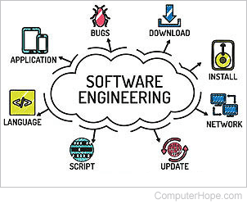

Slide 7
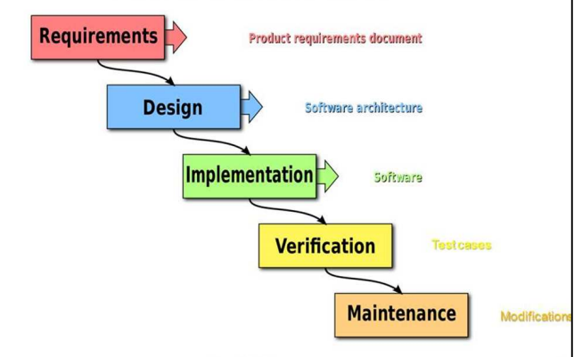

Slide 8
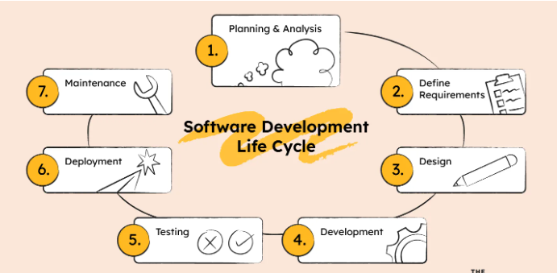

Slide 9
Process models in software development typically consist of several main phases. Here's a concise overview:
Requirements Gathering:
Identify and document the needs and expectations of users and stakeholders.
Planning:
Define project scope, resources, timeline, and activities required for successful completion.
Design:
Create high-level and detailed specifications for the software architecture and components.
Implementation (Coding):
Translate the design into actual code, following coding standards and best practices.
Testing:
Verify that the software functions correctly and meets the specified requirements through various testing phases.
Deployment:
Release the software for use, either in a controlled environment or to end-users.
Maintenance and Support:
Address issues, bugs, and changes that arise after deployment to ensure ongoing functionality.

Slide 10
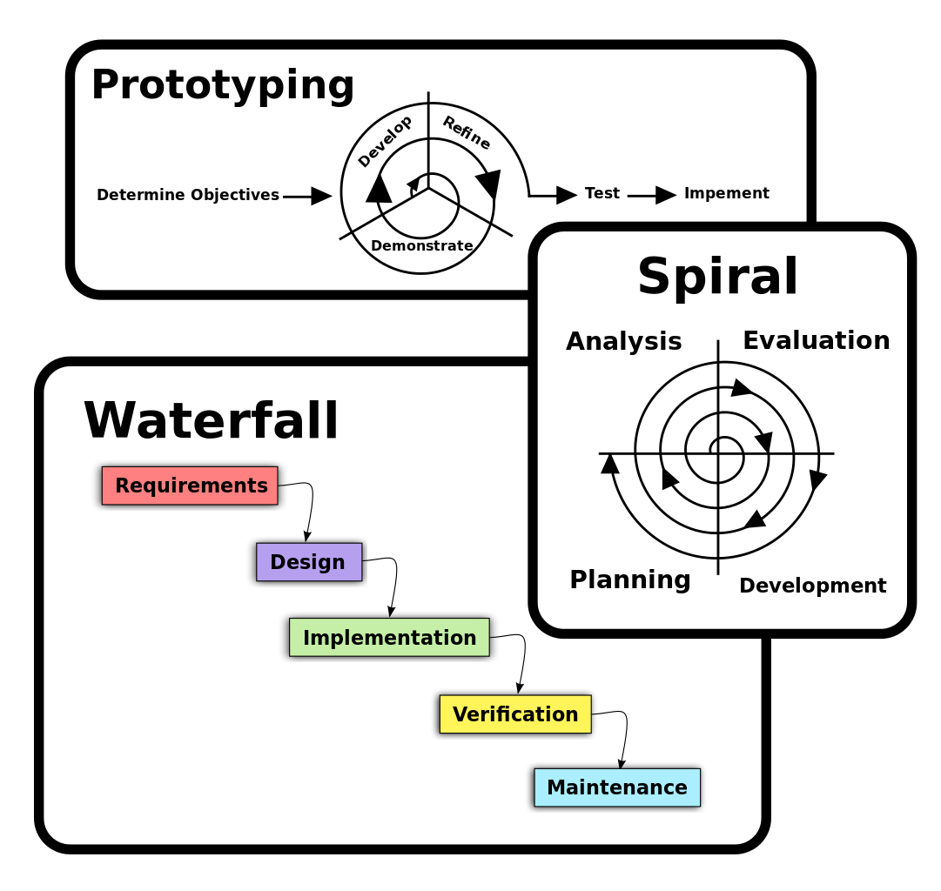
Types of process models

Slide 11
Types of process models

Slide 12
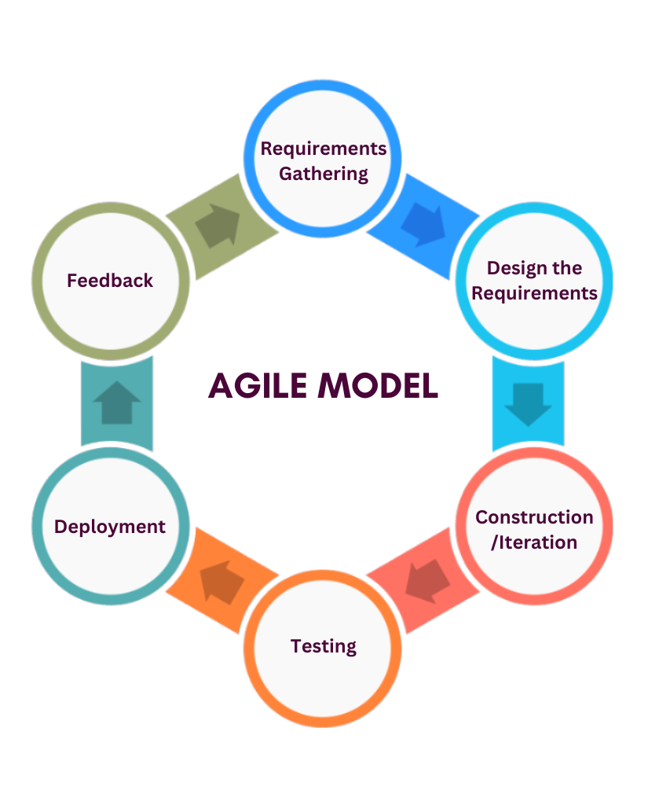

Slide 13
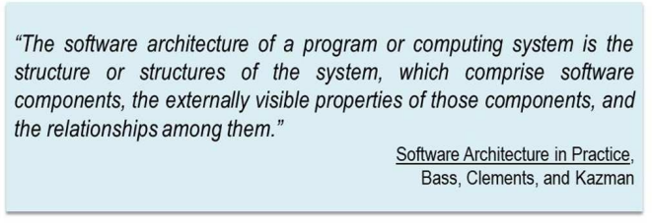
What is software architecture

Slide 14
What is software architecture
"Patterns of Enterprise Application Architecture" by Martin Fowler:
Martin Fowler's book explores patterns commonly encountered in enterprise-level software development. It provides a valuable resource for architects and developers dealing with the challenges of building large-scale applications.

Slide 15
What is software architecture?
David Perry and Alexander L. Wolf, in their paper titled "Foundations for the Study of Software Architecture," published in 1992, provided a widely referenced definition of software architecture. Here is their definition:
"Software architecture is the fundamental organization of a system, embodied in its components, their relationships to each other and the environment, and the principles governing its design and evolution."

Slide 16
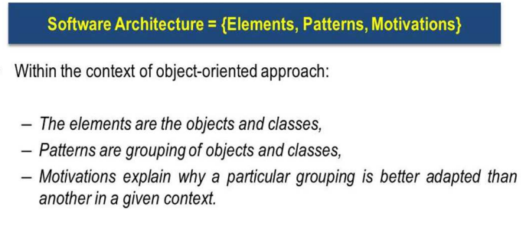
Perry and wolf formula for

Slide 17
Software Architecture
A software architecture is a description of the subsystems and components of a software system and the relationships between them
Subsystems and components are typically specified in different views to show the relevant functional and non-functional properties of a software system
The software system is an artifact. It is the result of the software design activity

Slide 18
Definition: Component
A component is an encapsulated part of a software system
A component has an interface
Components serve as the building blocks for the structure of a system
At a programming-language level, components may be represented as modules, classes, objects or as a set of related function

Slide 19
Definition: Sub systems
A subsystem is a set of collaborating
components performing a given task
A subsystem is considered a separate entity
within a software architecture
it performs its designated task by interacting with
other subsystems and components…

Slide 20
Components of Software Architecture:
Components:
Definition: Components are the building blocks or modules of a software system. These can be classes, modules, services, or other units of software that encapsulate specific functionality.
Representation in Diagram: Represented in architectural diagrams as boxes or nodes, each labeled with the name of the component.

Slide 21
Components of Software Architecture:
Relationships:
Definition: Relationships define how the components interact with each other. These interactions can include method calls, data flows, or other forms of communication.
Representation in Diagram: Represented by connecting lines or arrows between the components. Different types of relationships (e.g., association, dependency, or inheritance) may be depicted.

Slide 22
Components of Software Architecture:
Constraints:
Definition: Constraints are the limitations or restrictions on the design and implementation of the software system. These may include technological, organizational, or external constraints that influence the architectural decisions.
Representation in Diagram: Constraints are often documented in accompanying text or notes on the architectural diagrams. They may influence the choice of components or the nature of relationships.

Slide 23
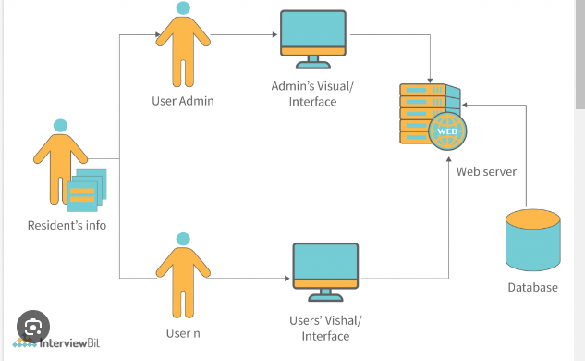

Slide 24
What is software design
Software design is a mechanism to transform user requirements into some suitable form, which helps the programmer in software coding and implementation. It deals with representing the client's requirement, as described in SRS (Software Requirement Specification) document, into a form, i.e., easily implementable using programming language.
The software design phase is the first step in SDLC (Software Design Life Cycle), which moves the concentration from the problem domain to the solution domain. In software design, we consider the system to be a set of components or modules with clearly defined behaviors & boundaries.

Slide 25
What is software design
Software design refers to the process of specifying how a software system will be implemented. It involves making decisions about the software's structure, components, modules, interfaces, and algorithms. The primary goal of software design is to transform the requirements specified in the software requirements specification into a design that can be implemented efficiently and effectively.

Slide 26
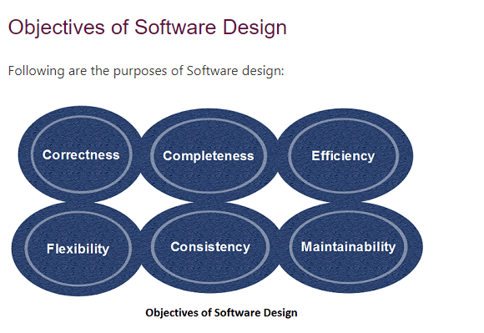

Slide 27
Purpose of software design
Correctness:Software design should be correct as per requirement.
Completeness:The design should have all components like data structures, modules, and external interfaces, etc.
Efficiency:Resources should be used efficiently by the program.
Flexibility:Able to modify on changing needs.
Consistency:There should not be any inconsistency in the design.
Maintainability: The design should be so simple so that it can be easily maintainable by other designers.

Slide 28

definition

Slide 29
Differences
S.No. | SOFTWARE DESIGN | SOFTWARE ARCHITECTURE
01. | Software design is about designing individual modules/components. | Software architecture is about the complete architecture of the overall system.
02. | Software design defines the detailed properties. | Software architecture defines the fundamental properties.
03. | In general it refers to the process of creating a specification of software artifact which will help to developers to implement the software. | In general it refers to the process of creating high level structure of a software system.

Slide 30
Differences
04. | It helps to implement the software. | It helps to define the high level infrastructure of the software.
05. | Software design avoids uncertainty. | Software architecture manages uncertainty.
06. | Software design is more about on individual module/component. | Software architecture is more about the design of entire system.
07. | It is considered as one initial phase of Software Development Cycle (SSDLC) and it gives detailed idea to developers to implement consistent software. | It is a plan which constrains software design to avoid known mistakes and it achieves one organizations business and technology strategy.
08. | Some of software design patterns are creational, structural and behavioral. | Some of software architecture patterns are microservice, server less and event driven.

Slide 31
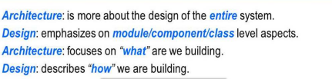
Bigger context

Slide 32
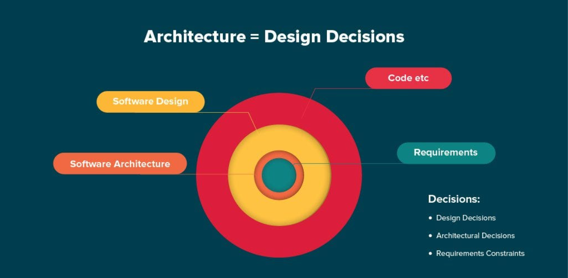

Slide 33
Functional requirement
These are the requirements that the end user specifically demands as basic facilities that the system should offer. All these functionalities need to be necessarily incorporated into the system as a part of the contract.
Example:
What are the features that we need to design for this system?
What are the edge cases we need to consider, if any, in our design?

Slide 34
Non-Functional Requirements
These are the quality constraints that the system must satisfy according to the project contract. The priority or extent to which these factors are implemented varies from one project to another. They are also called non-behavioral requirements. They deal with issues like:
Portability
Security
Maintainability
Reliability
Scalability

Slide 35
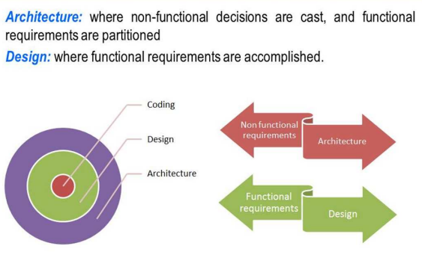

Slide 36
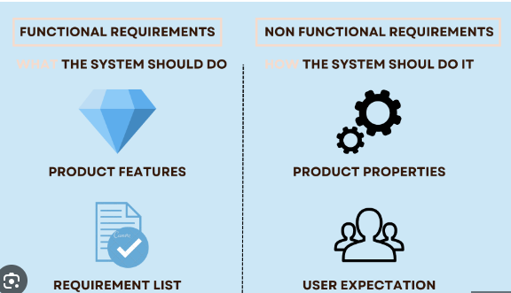

Slide 37
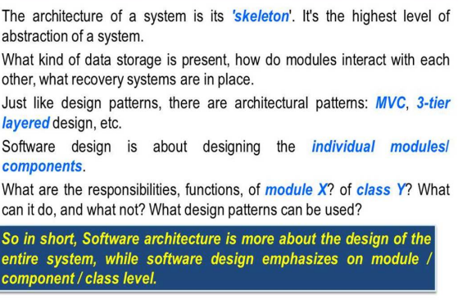

Slide 38
To create your own architecture design
https://www.edrawmax.com/architecture-diagram/create-architecture-diagram-online/

